Slide 1
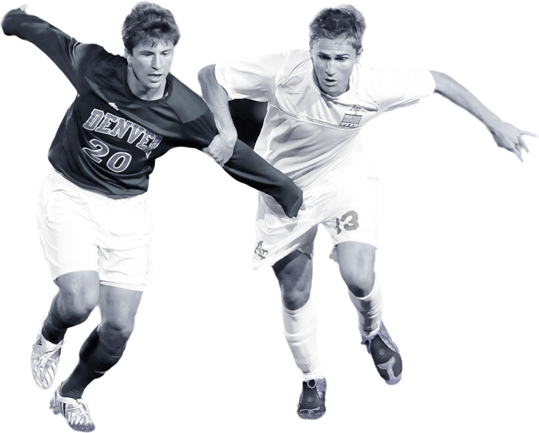

AC Millan Performance Analysis
Group 7

Slide 2
1
Case Study: Ibrahimović
AGENDA
Football Network Analysis
2
3
Conclusion

Slide 3

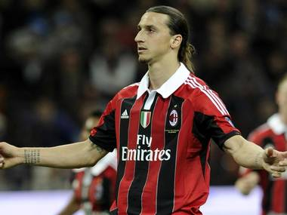
Learning from the Ibrahimović Debacle
Notes:
Ibra was playing for Barcelona and was having issues with the manager Pep Guardiola. He began looking around for a new situation and because he recently left Inter Milan to join Barcelona, he naturally looked to the place he was most familiar, Milan. AC Milan came calling and the combination of vengeance for his old club and familiarity with the players on AC Milan led him to this new club. “I am familiar with Alexandre Pato and Ronaldinho, we have a fantastic attack. No, it depends on us. I think Milan fans will have fun watching the three of us play at the stadium.” Along with the two players mentioned above, Ibrahomovic had many connections to AC Milan and it seems his decision was mostly made based on his familiarity with the squad. After a bittersweet reunion and glorious reception by the AC Milan players, the situation couldn’t have been worse. Ibrahimovic was not the player many of the AC Milan players remembered and he did not truly fit the team in Milan. Just 12 months into his contract AC Milan shipped him out to Paris Saint Germain for less money than they bought him for 12 months prior. “ He has always been the one to decide his destiny, except on this occasion” said the president of AC Milan years later.

Slide 4
In Zlatan Ibrahimović's boots
2011
2012
First Season on AC Milan
PSG Transfer
Zlatan struggles to establish himself scoring only 14 Goals
Transfers to PSG solely for football reasons and has 2 past teammates on the team
K = 6
K = 2
Transfer Fee:
Transfer Fee:
£21,600,000
£18,900,000
2011
2012
2012-
First move
Second Season on AC Milan
Zlatan the Legend
Zlatan Ibrahimović moves to AC Milan because of past teammates who are playing on AC Milan and his comfort level with the city
Zlatan Plays better but still has many off the field issues and manager expects more from him
After leaving Milan Zlatan becomes a legend at PSG

Slide 5
Analysis
Football Network

Slide 6
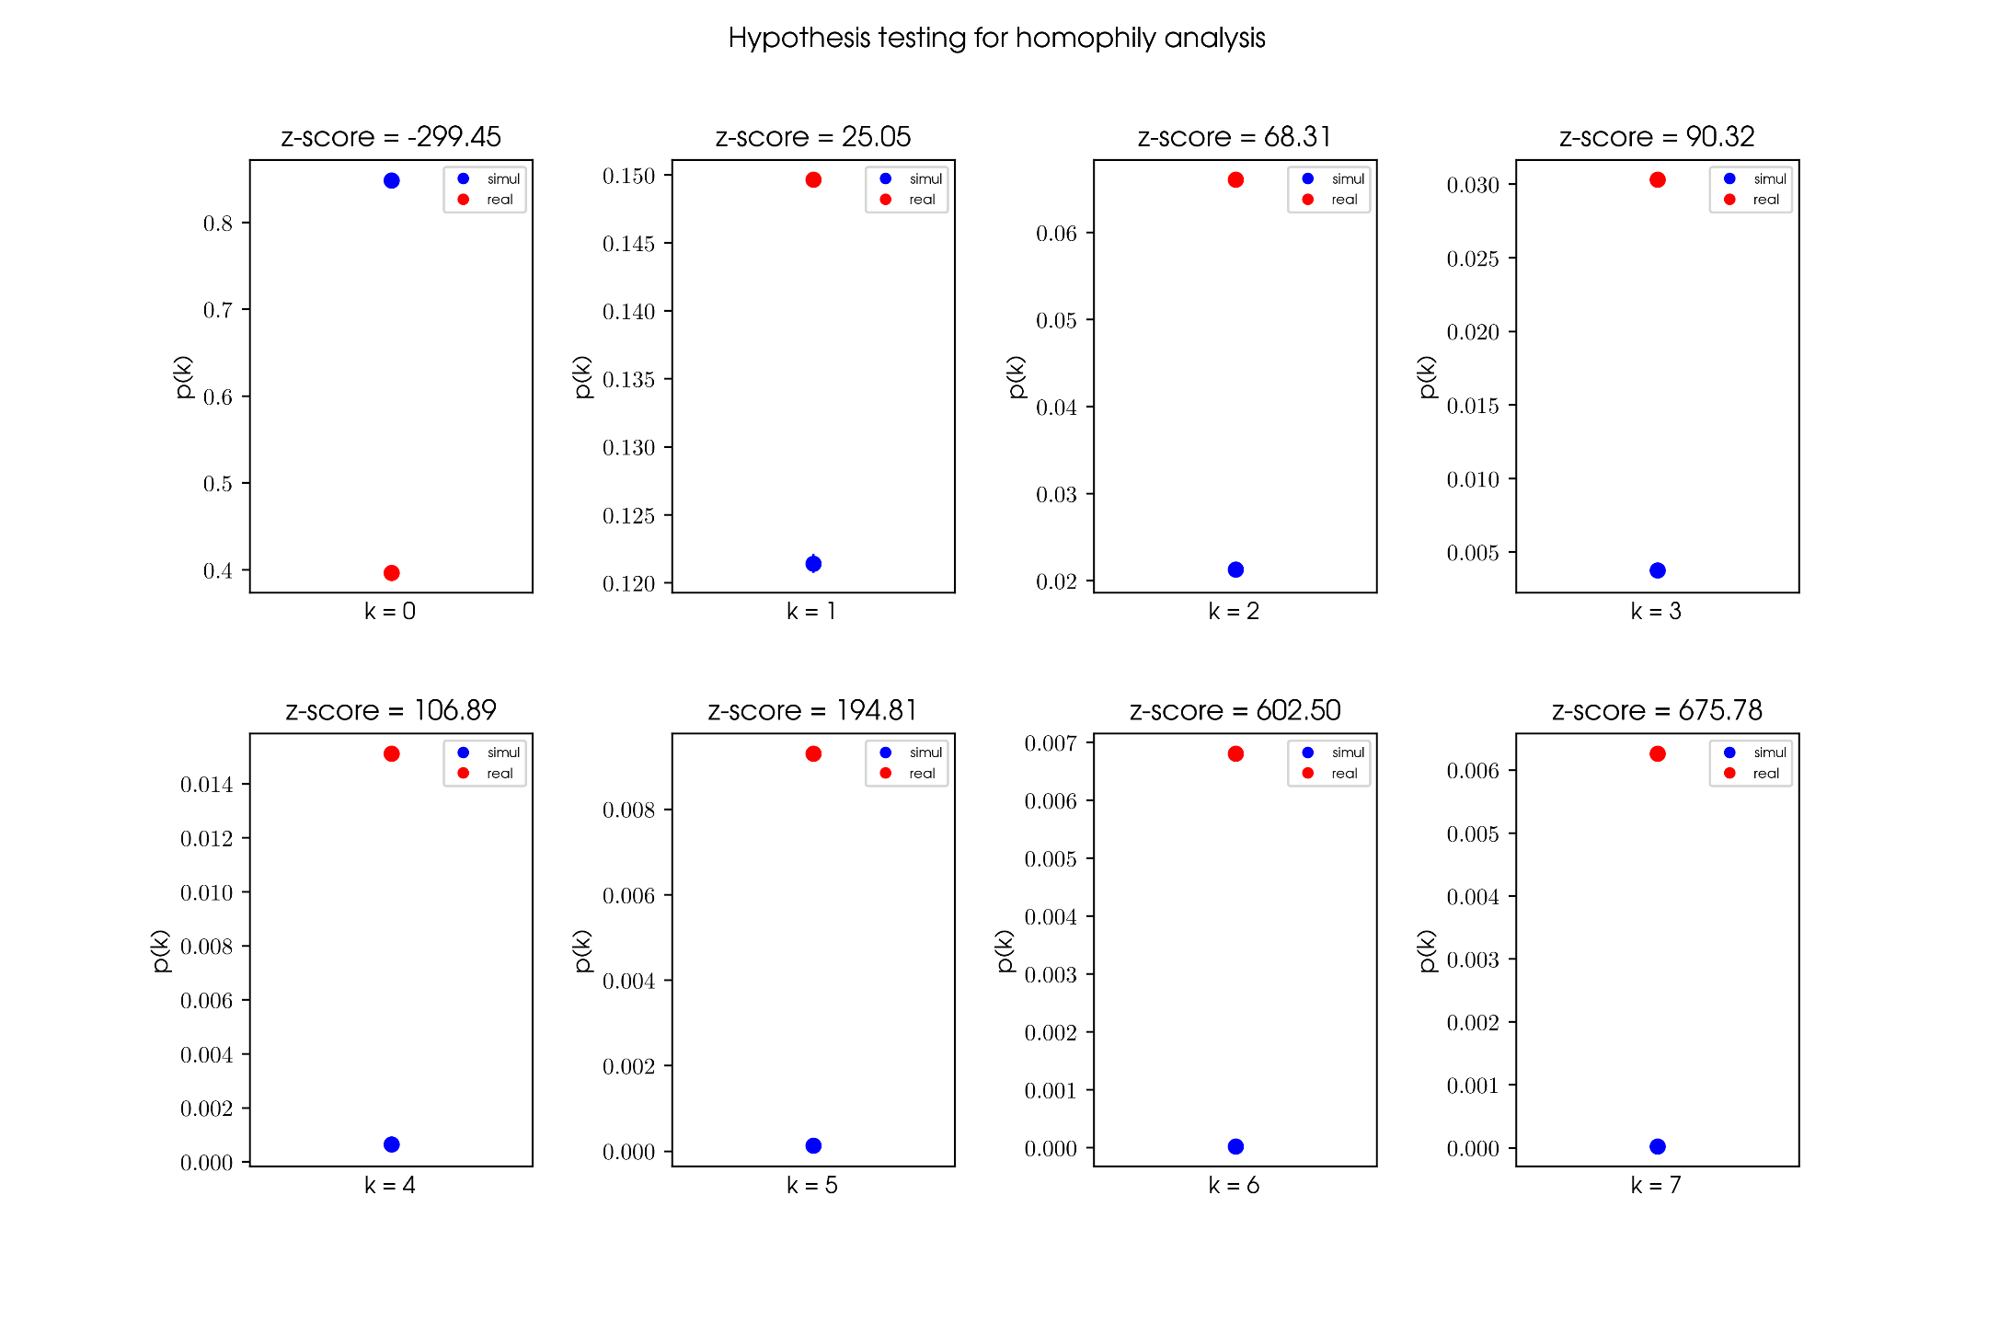

Is there Homophily in Football?
Notes:
YES THERE IS!!!

Slide 7
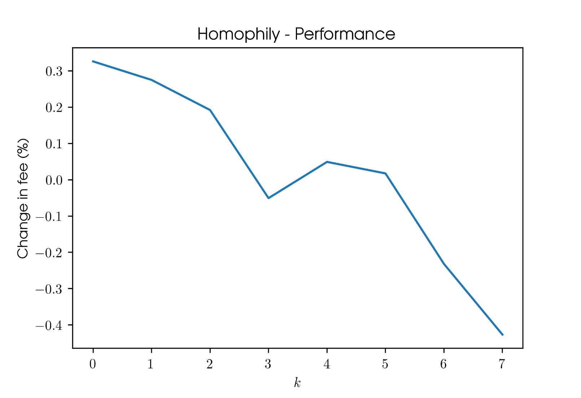
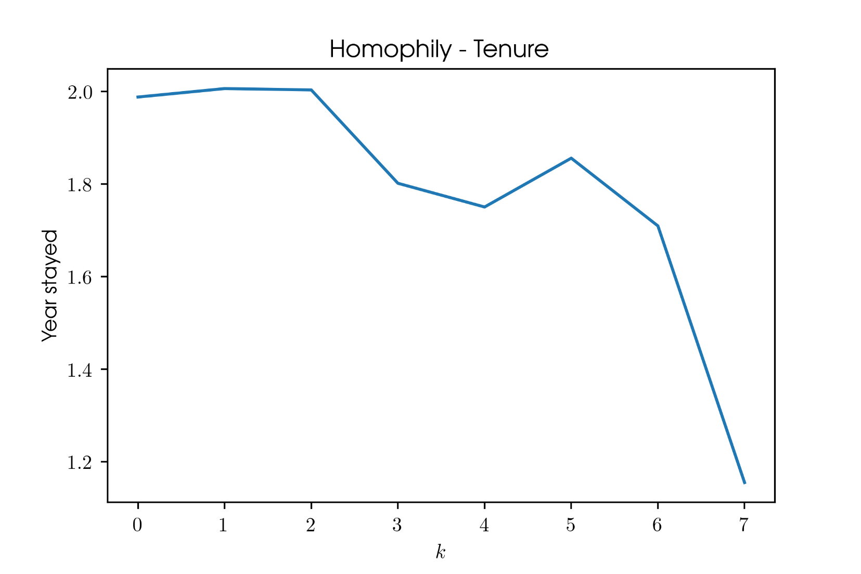
The Impact of Homophily
Notes:
NEGATIVE AFFECT ON PERFORMANCE

Slide 8
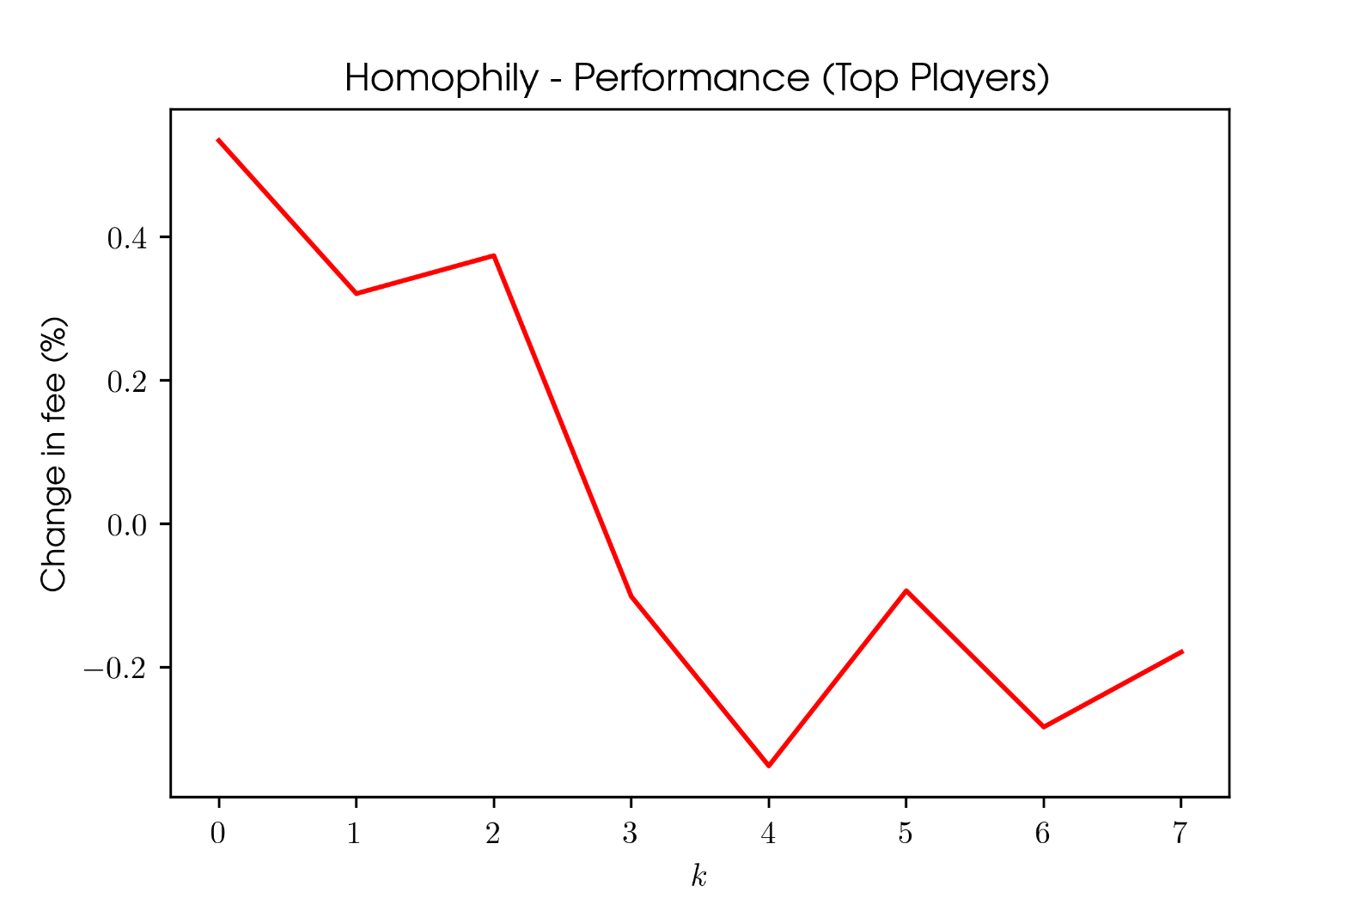
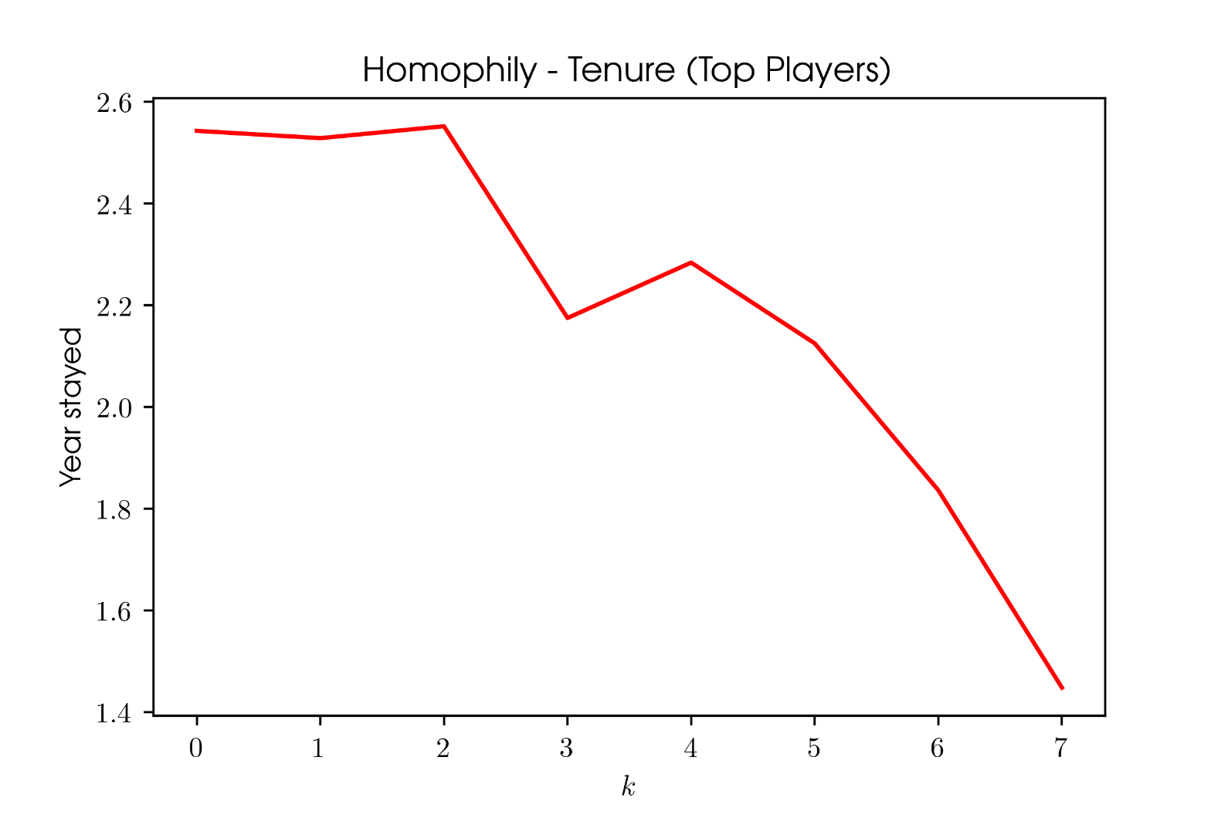
Impact of Homophily on Top Players
Notes:
NEGATIVE AFFECT ON PERFORMANCE

Slide 9
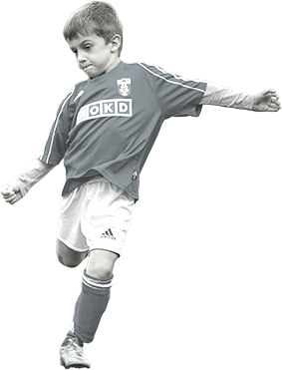
Conclusion

Slide 10
Conclusion
SUMMARY
Homophily is present in the football network
Homophily has a negative relationship with transfer fee and tenure
A high degree of homophily causes a regression in the performance or value of players. This can be based on several circumstances
RECOMMENDATION
AC Milan should avoid buying players based on an assumed familiarity
Avoid considering personal relationships and focus on football information for decision making
Notes:
Situations where there is a high degree of homophily typically end up causing regression in a player’s performance or value. This can be based on:
Lack of emphasis on football strategy during the deal
Unrealistic expectations set by either the player or the organization
Overlooking of a potential issue by either party during the transaction because of the distraction of familiarity
To much focus on relationships and not enough on football
Overlooking the fit of the player on the current squad

Slide 11


Thank You!

